Slide 1
EECT 112 Digital Fundamentals
Alex Drummond
Partners included: Jarred Clark, Seth Wills, Jose Tapia, Emmanuel Ayiku-Teye

Slide 2
Lab 1: Logic Level Date:9-8-17
Partner: Steve Kepler
Purpose:
To test how to create logic levels for digital circuits using switches and resistors
What equipment was needed:
1-Digatal Multimeter
4-10Kohm
1-4 position dip switch

Slide 3
Lab 1: Page Two Multisim and Simulated Results
 | Simulated
 | Open | Closed
VA | 4.999 | 50nv
VB | 4.999 | 50nv
VC | 499.945nv | 5v
VD | 499.94nv | 5v
In the simulation we used 4 switches and 4 10k resistors we had resistors before the switches and after the switches

Slide 4
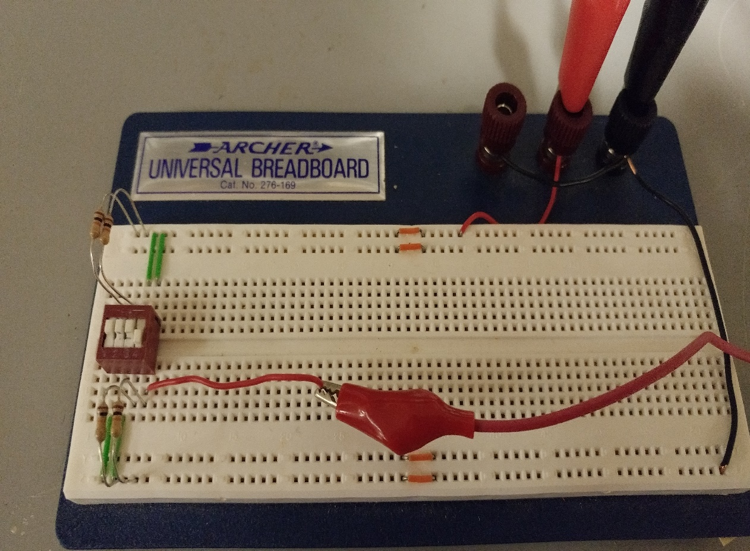
Lab 1: Tested Pictures and Results
 | Tested
 | Open | Closed
VA | 4.9887 | 0
VB | 4.9887 | 0
VC | 0 | 4.9932
VD | 0 | 4.9332

Slide 5
Observation
When gate VA and VB where open on both the test and simulation we would get a state of close to 5V but if they were closed we would get a state close to 0V . If VC and VD where open then you get a state of zero but if they were closed you would get a state close to 5v.

Slide 6
Lab 2: Number Conversions Date: 9-15-17
Purpose of the lab
Lean how to convert numbers from one base to another base
What I used:
Excel Sheets

Slide 7
Lab 2: Page 2
Using the Lecture 2a Slide 3.xlxs spreadsheet determine the decimal values for the min and max binary numbers.
5 Bit Binary Min: 00000 Decimal value =0
5 Bit Binary Max: 11111 Decimal value =31
8 Bin Binary Max: 1111 1111 Decimal value =255
8 Bin Binary Min: 0000 0000 Decimal value =0
Using the Lecture 2a Slide 5.xlxs spreadsheet determine what decimal value is equal to the maximum binary number for 6 and 7 bits.
6 Bit Binary Max: 111111 Decimal value =63
7 Bit Binary Max: 1111111 Decimal value =127

Slide 8
Lab 2: Page 3
Using the Lecture 2a Slide 7.xlxs spreadsheet determine what decimal values are equal to for the minimum and maximum binary numbers.
Min Decimal No:0 Binary value =00000
Max Decimal No:31 Binary value =11111
Using the Lecture 2a Slide 9.xlxs spreadsheet determine what decimal values are equal to for the minimum and maximum binary numbers.
Min Decimal No:0 Binary value =0000000
Max Decimal No:63 Binary value =111111

Slide 9
Lab 2 page 4
Using the Lecture 2a Slide 12.xlxs spreadsheet determine what hexadecimal value are equal to for the minimum and maximum decimal numbers.
Min Hexadecimal No: 000 Decimal value = 0
Max Hexadecimal No: FFF Decimal value = 4095
Using the Lecture 2a Slide 14.xlxs spreadsheet determine what decimal value produces a value of the following values.
Hexadecimal Decimal
000 000
03F 63
07F 126
0FF 255
FFF 4095

Slide 10
Lab 2: Page 5
Using the Lecture 2a Slide 18.xlxs spreadsheet determine what decimal value is equal to the maximum hexadecimal number and binary number.
Max Decimal value =15 15 15
Hexadecimal value =F F F
Binary value = 1111 1111 1111

Slide 11
Lab 2: Observations
My observations for lab 2 were that binary numbers consist of ones and zeros. Binary has a base of two while Decimal number has a base of 10. Hexadecimal consist of numbers and letters 1 through F.
Binary:
2^2
Decimal
10^2
Hexadecimal
16^2

Slide 12
Lab 3: Logic Gates Date: 9-29-17
Lab Partner: Emmanuel Ayiku-Teye
Purpose of the lab:
To test How to test AND and OR gates
Equipment Needed:
1 – Digital Multimeter
2 – 10Kohm
1 – 4 position dip switch
1 – 74LS08
1 – 74LS32

Slide 13
Lab 3: Multisim
This multisim we tested the output with a 74ls08 gate also known as the AND gate
In this multisim we tested the output of the 74ls32 gate which is also known as the OR gate

Slide 14
Lab 3: Results for AND Gate
 | Simulated
S1 | S2 | Output
0 | 0 | 0
0 | 1 | 0
1 | 0 | 0
1 | 1 | 1
 | Tested
S1 | S2 | Output
0 | 0 | 0
0 | 1 | 0
1 | 0 | 0
1 | 1 | 4.4V
Enter excel here

Slide 15
Lab 3: Results for OR Gate
 | Simulated
S1 | S2 | Output
0 | 0 | 0
0 | 1 | 1
1 | 0 | 1
1 | 1 | 1
 | Simulated
S1 | S2 | Output
0 | 0 | 0
0 | 1 | 1
1 | 0 | 1
1 | 1 | 1
 | Tested
S1 | S2 | Output
0 | 0 | 0
0 | 1 | 4.4
1 | 0 | 4.4
1 | 1 | 4.4
Lab 3 word doc

Slide 16
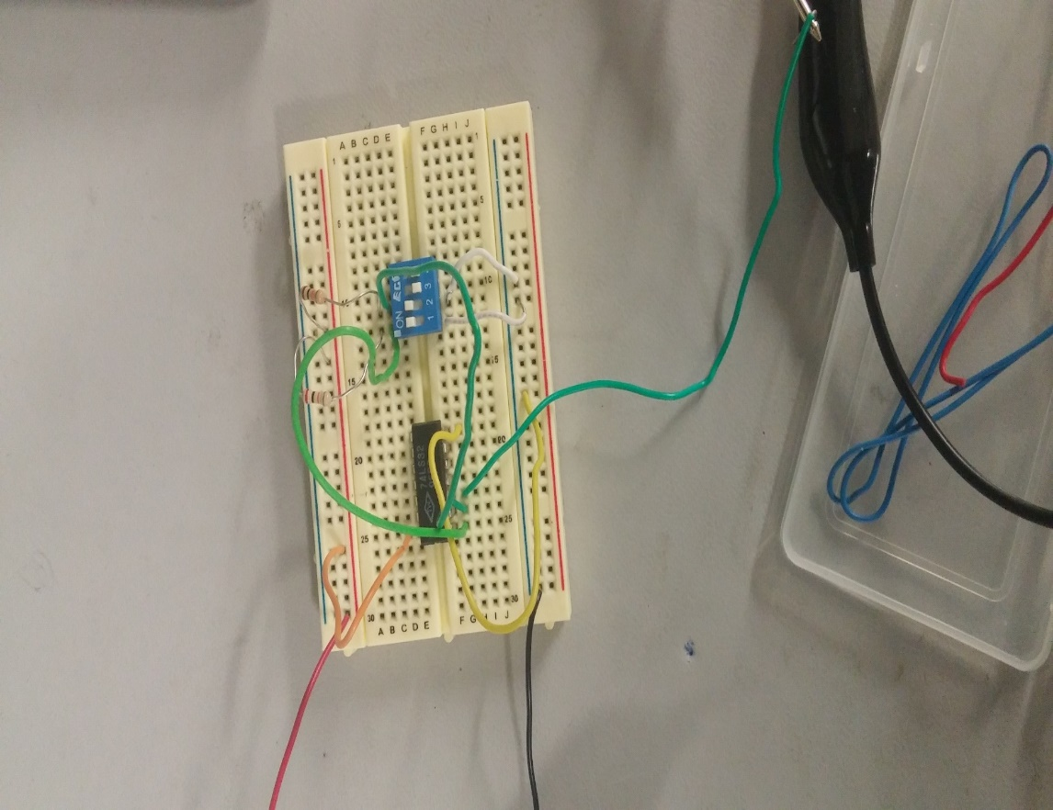
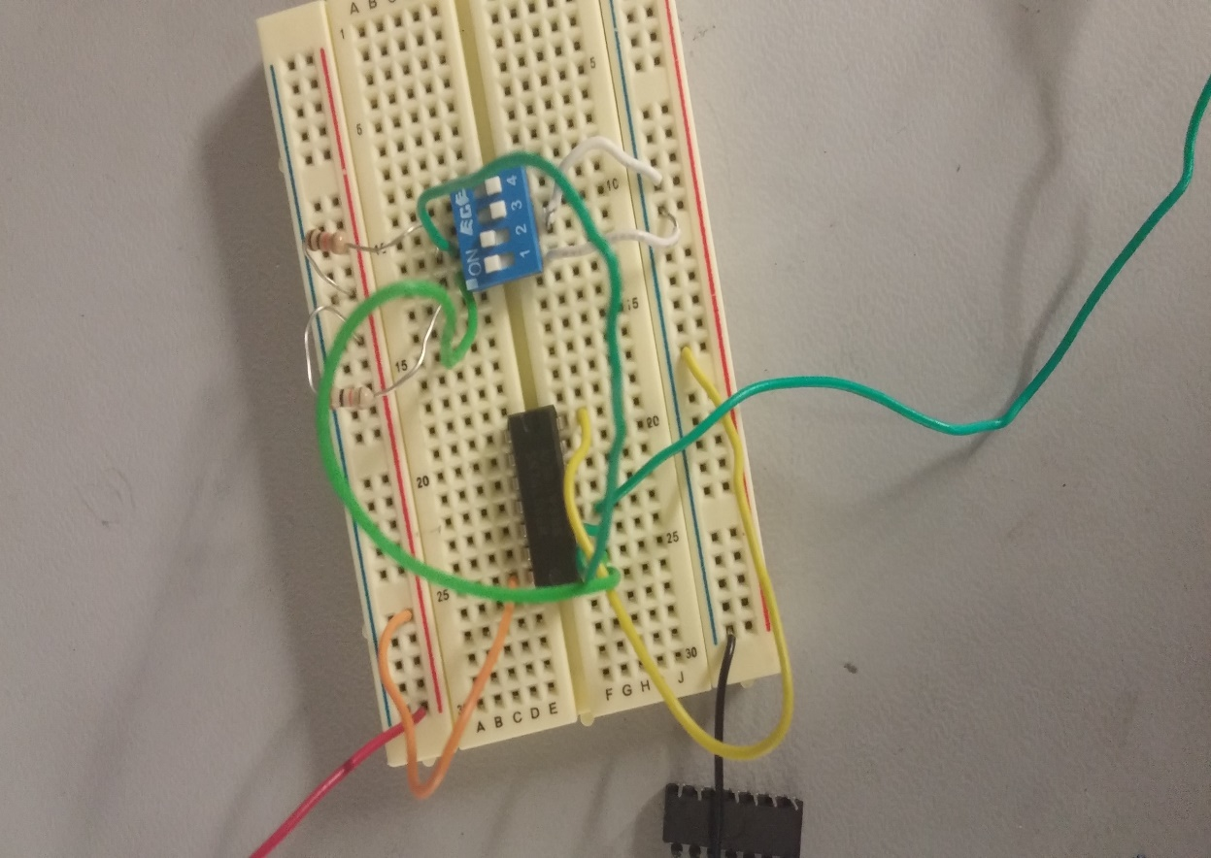
Lab 3: Pictures
This is the tested of the multisim with the 74ls32 gate also known as the OR gate
This is the tested multisim with the 74ls08 also known as the AND gate

Slide 17
Observations
My observations are that an AND gate only has one state that makes the output come out as an on state which is when all states are ones. While the OR gate only has one state where the output results in a zero which is when the state is all zeros

Slide 18
Lab 4 Date:10-6-17
Lab Partner: Emmanuel Ayiku-Teye
The purpose of this lab is to:
Test more about describing Logic Circuits algebraically
Equipment needed:
1 – Digital Multimeter
3 – 10Kohm
1 – 4 position dip switch
1 – 74LS08
1 – 74LS32

Slide 19
Lab 4: Multisims
In this multisim the output of the AND gate is connected to the input of the or gate while the 3rd switch is connected to the OR gate
In this multisim the output of the OR gate is connected to the AND gate while the 3rd gate is connected to the input of the AND gate

Slide 20
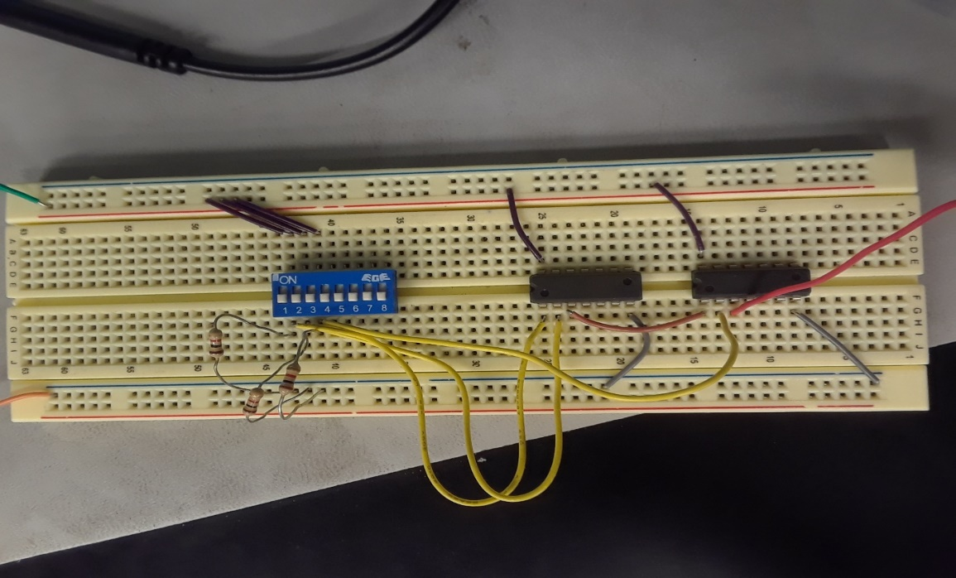
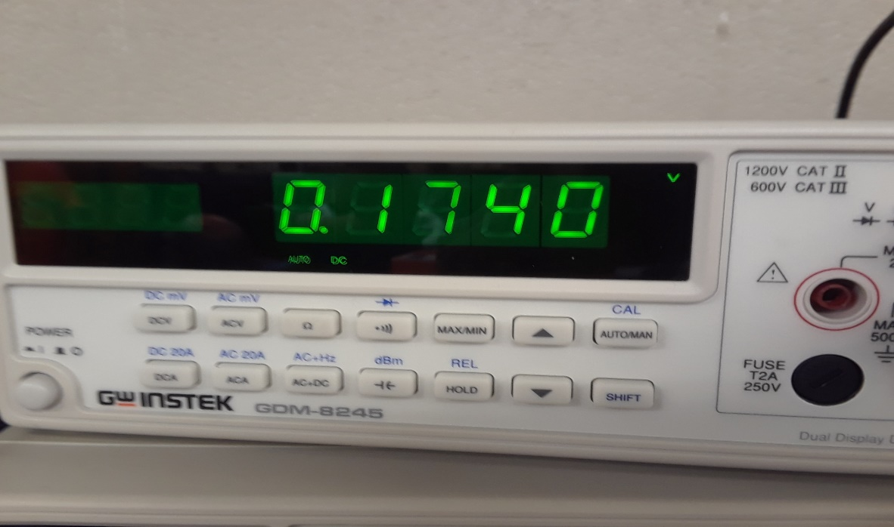
Lab 4:Pics
This is the read when all switches are off in the multisim where the output of the AND gates goes into the input of the OR gate . We read a voltage of .1740. (0,0,0)

Slide 21
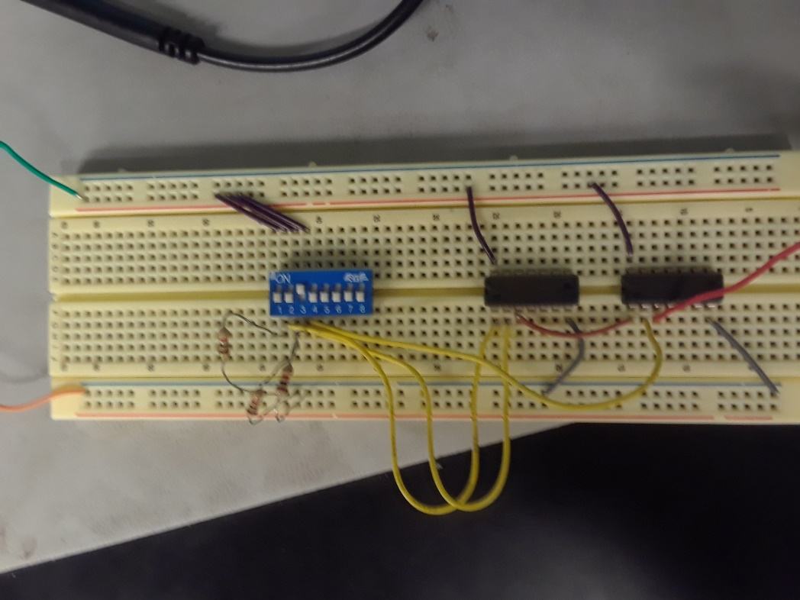
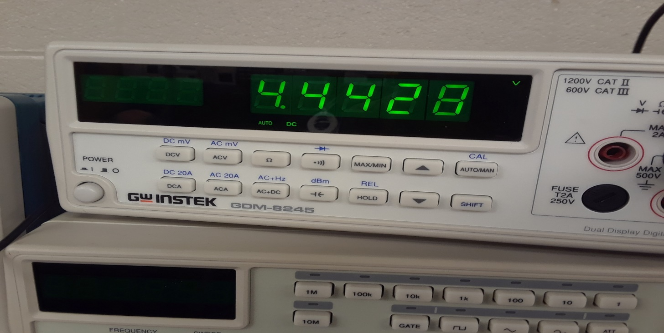
Lab 4: Pics
This is the read when switch3 is on in the multisim where the output of the AND gates goes into the input of the OR gate. We read a voltage of 4.4428. (0,0,1)

Slide 22
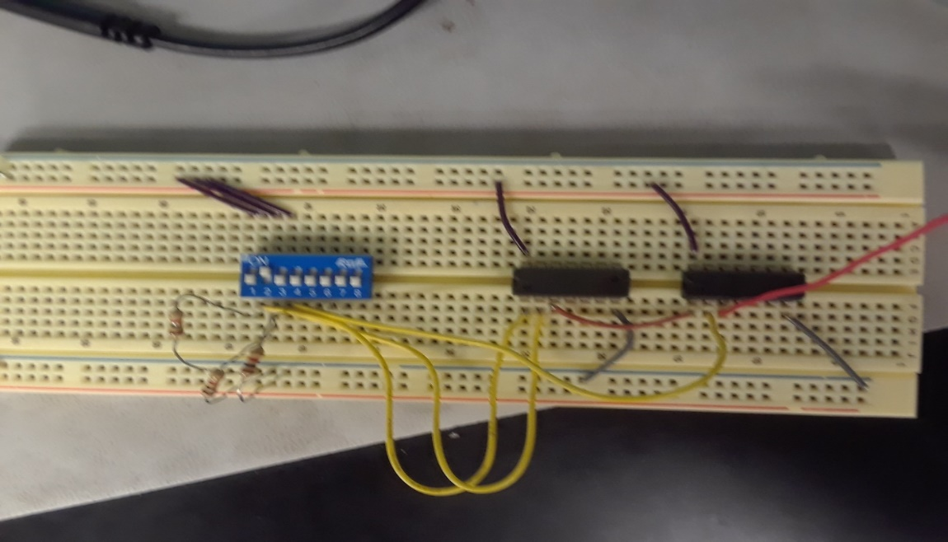
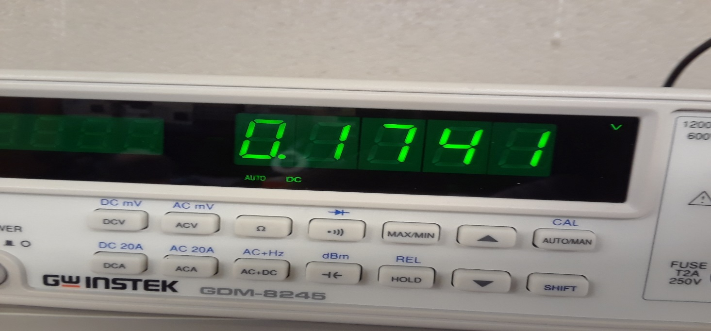
Lab 4 Pics
This is the read when switch 2 is on in the multisim where the output of the AND gates goes into the input of the OR gate . We read a voltage of .1741

Slide 23
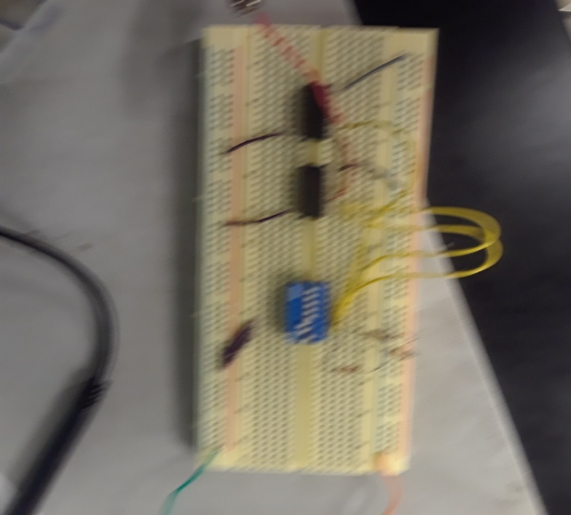
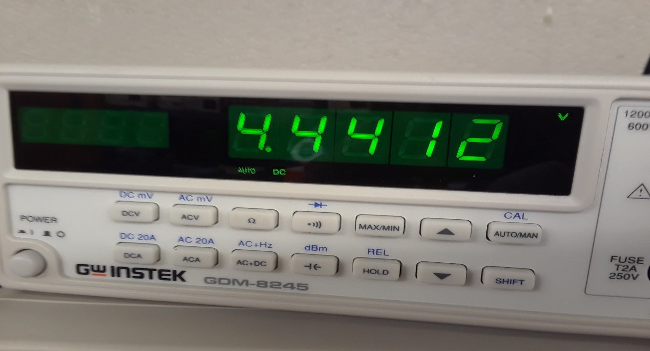
Lab 4: Pics
This is the read when switches 2 and 3 are on in the multisim where the output of the AND gates goes into the input of the OR gate . We read a voltage of 4.4412. (0,1,1)

Slide 24
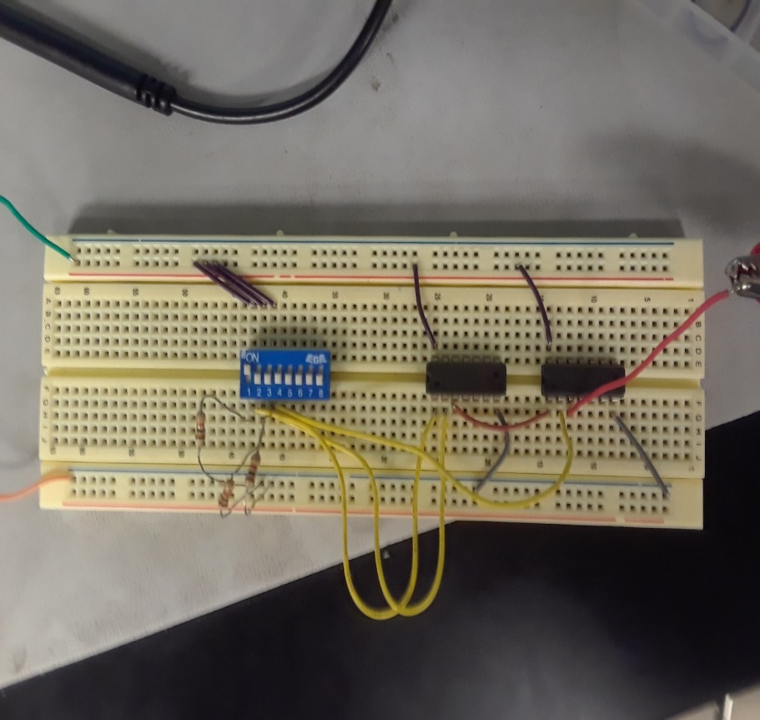
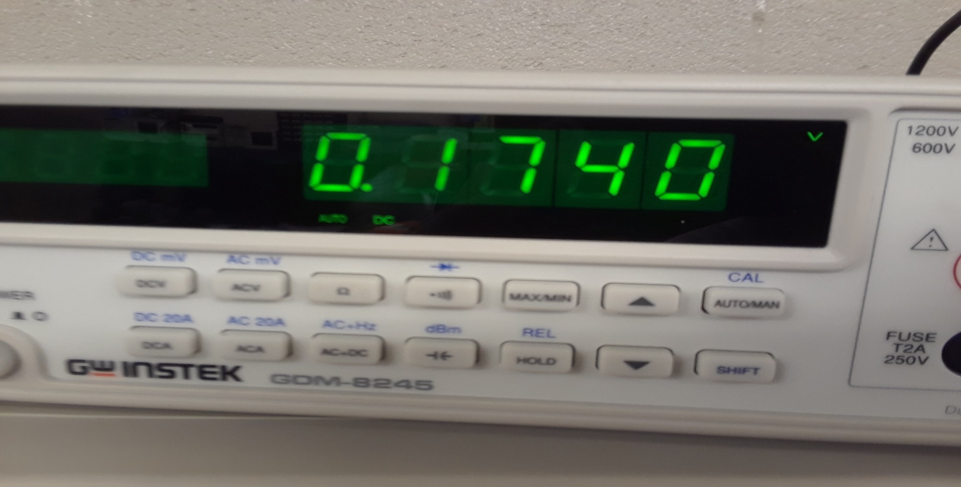
Lab 4: Pics
This is the read when switch 1 is on in the multisim where the output of the AND gates goes into the input of the OR gate . We read a voltage of .1740. (1,0,0)

Slide 25
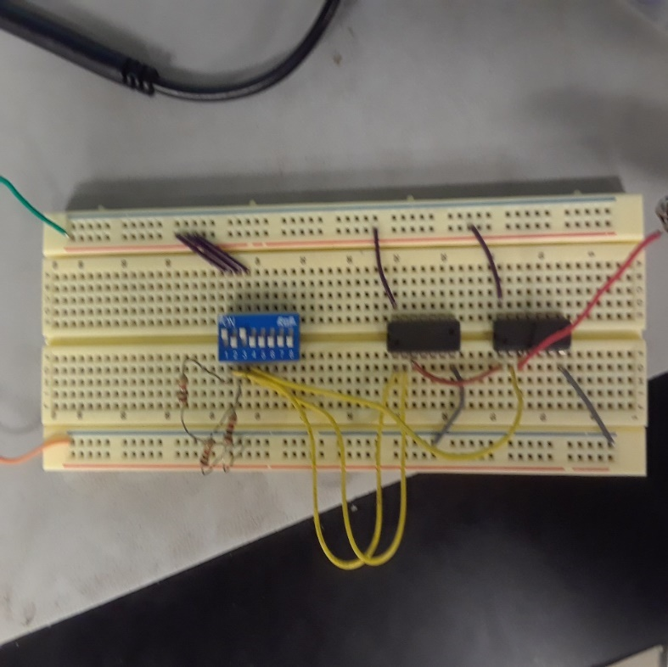
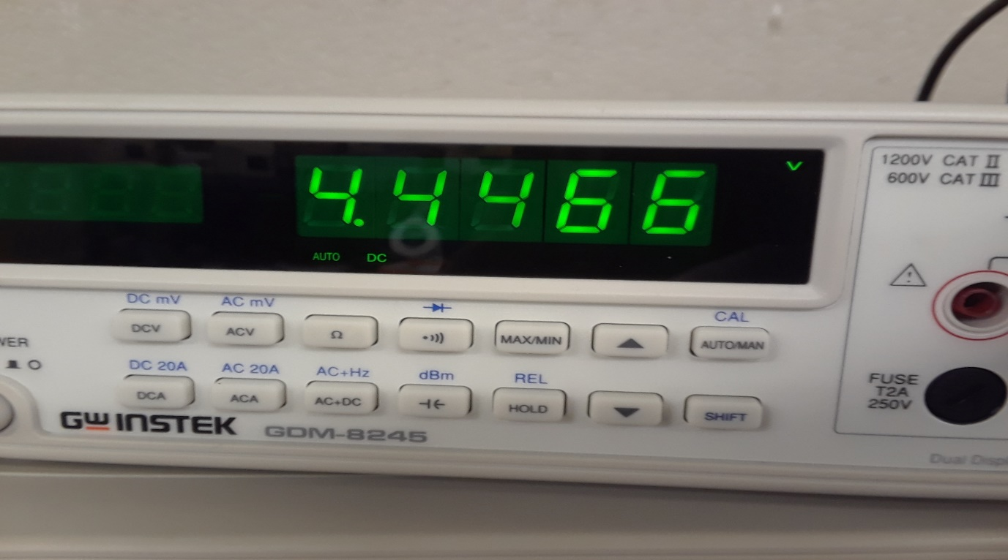
Lab 4:Pics
This is the read when switches 1 and 3 are on in the multisim where the output of the AND gates goes into the input of the OR gate . We read a voltage of 4.4466 (1,0,1)

Slide 26

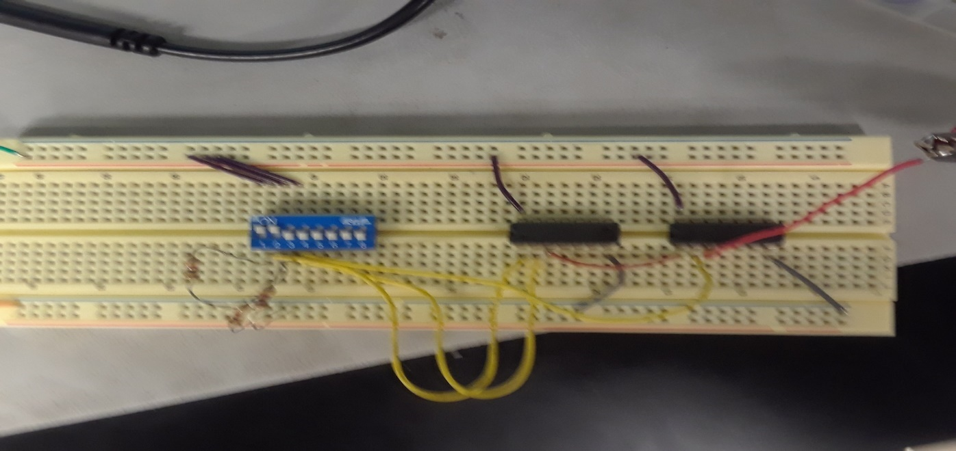
Lab 4: Pics
This is the read when switches 1 and 2 are on in the multisim where the output of the AND gates goes into the input of the OR gate . We read a voltage of 4.4466. (1,1,0)

Slide 27
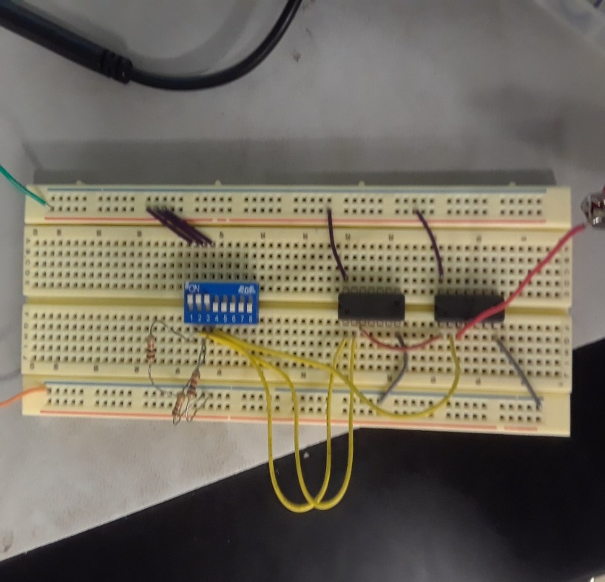
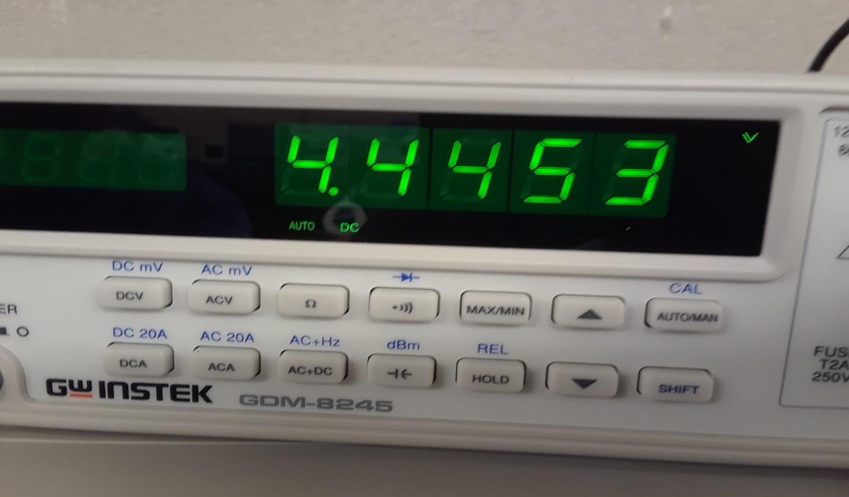
Lab4:Pics
This is the read when all switches are on in the multisim where the output of the AND gates goes into the input of the OR gate . We read a voltage of 4.4453

Slide 28
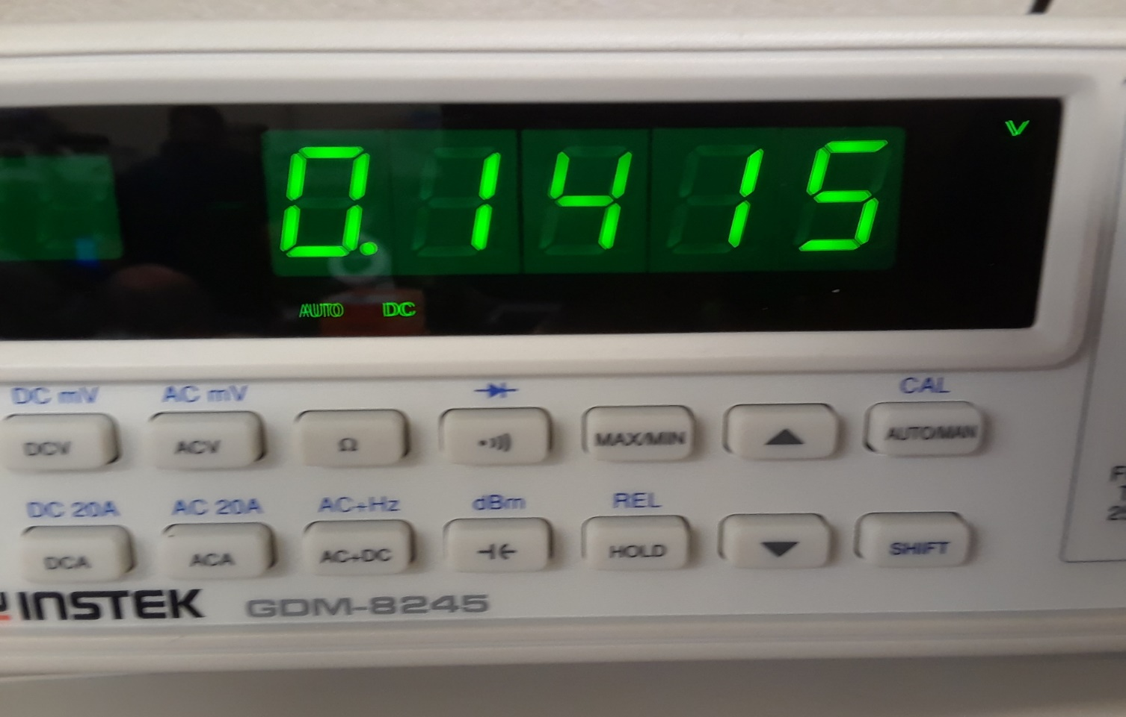
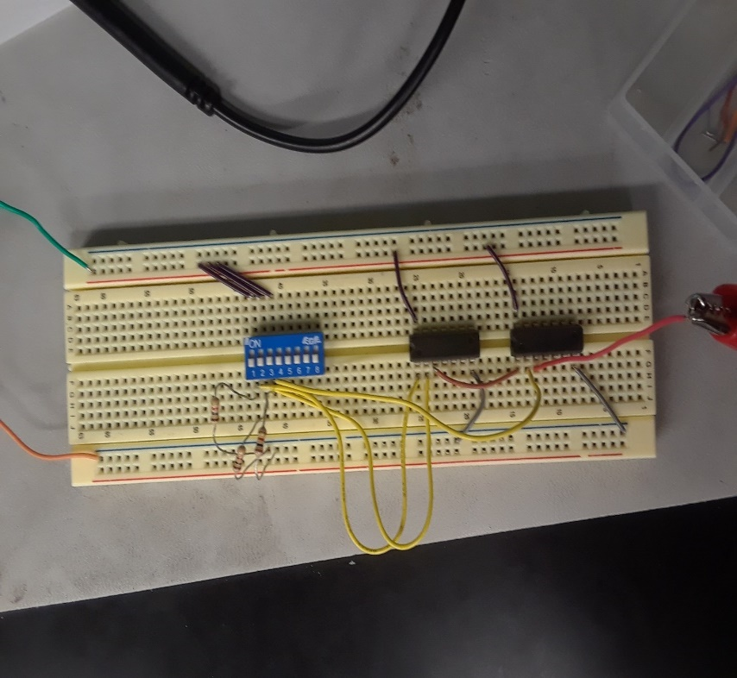
Lab 4: Pics
This is the read when all switches are off in the multisim where the output of the OR gates goes into the input of the AND gate . We read a voltage of .1415. (0,0,0)

Slide 29
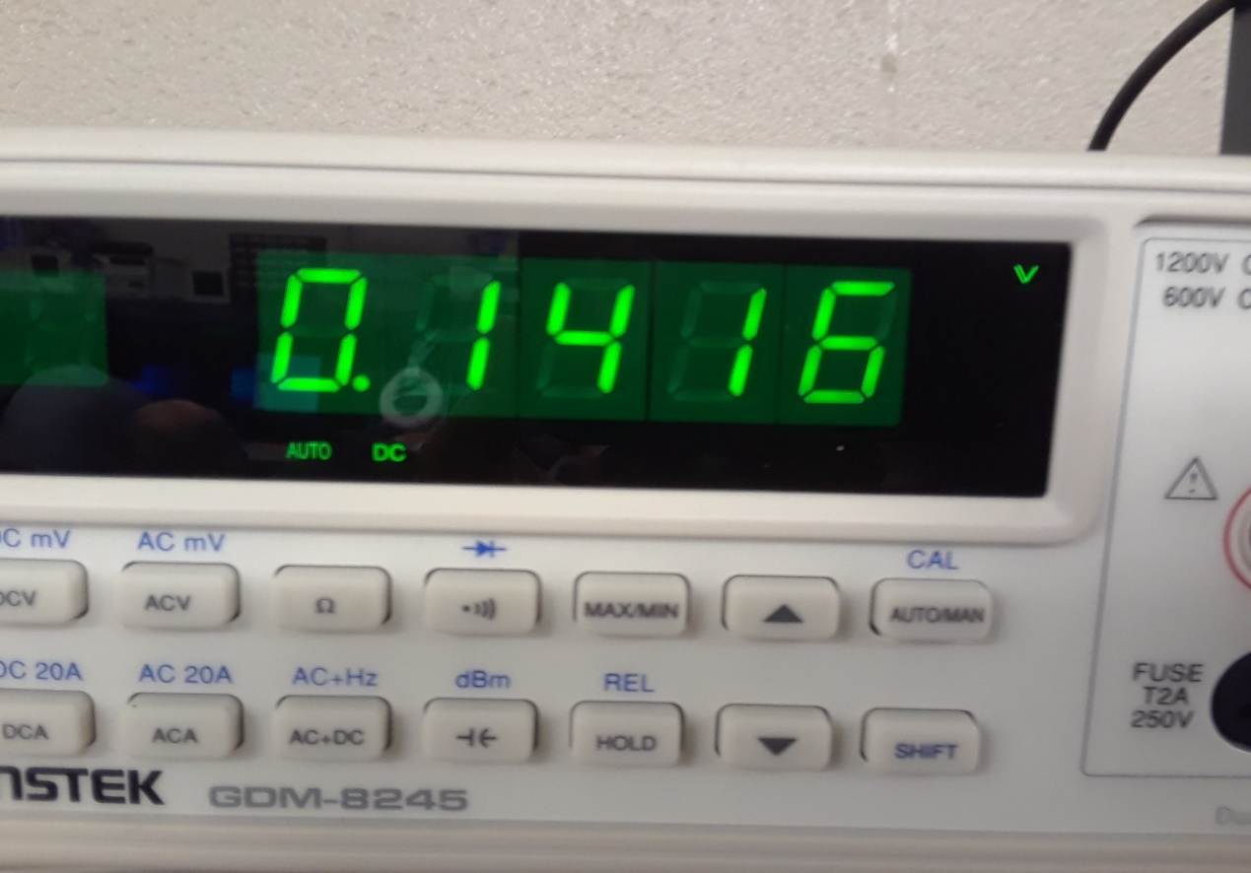
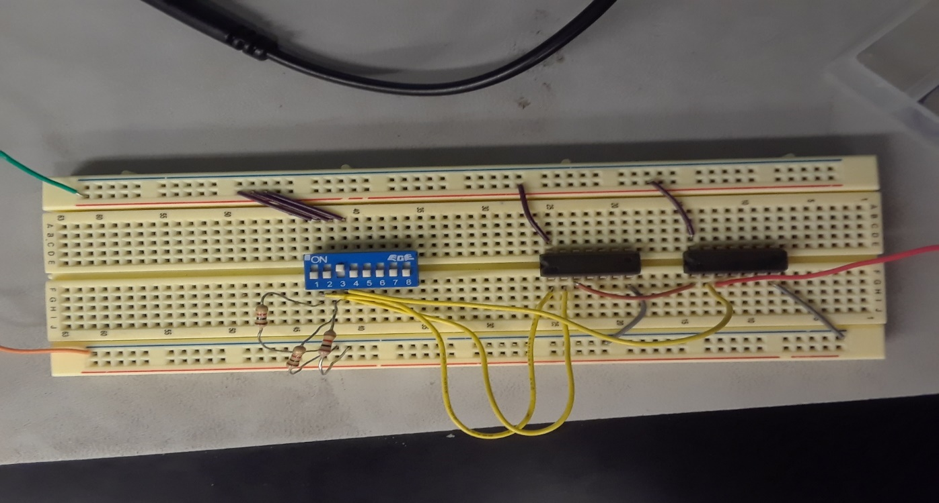
Lab 4: Pics
This is the read when switch 3 is on in the multisim where the output of the OR gates goes into the input of the AND gate . We read a voltage of .1416. (0,0,1)

Slide 30
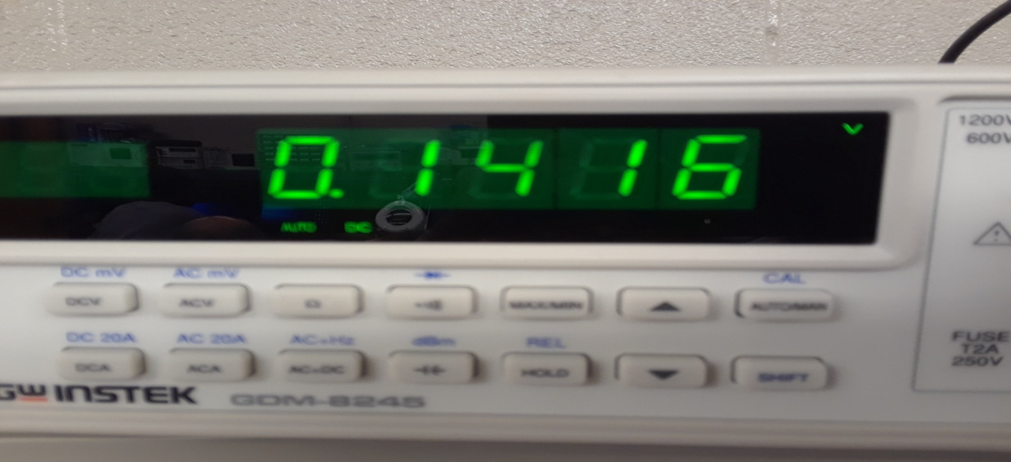
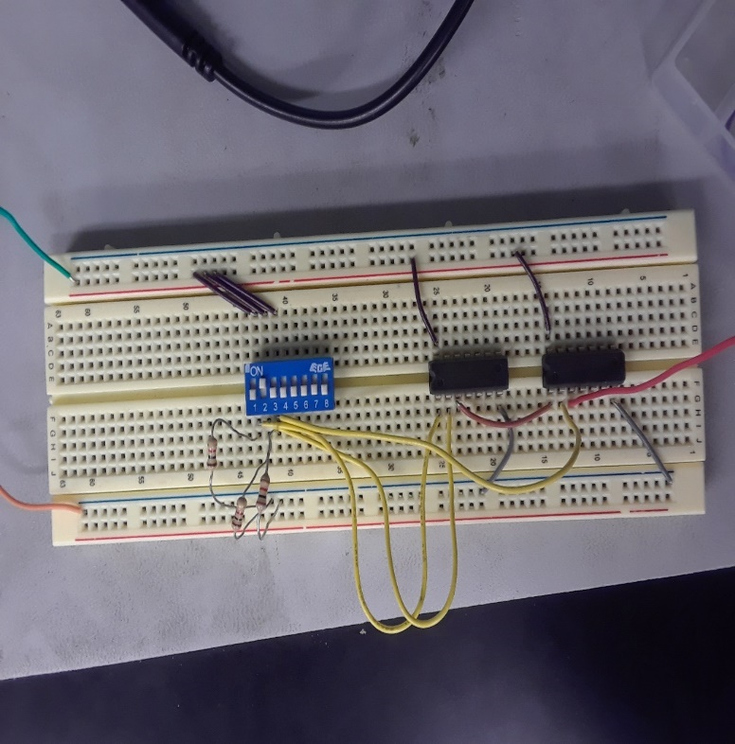
Lab 4: Pics
This is the read when switch 2 in the multisim where the output of the OR gates goes into the input of the AND gate . We read a voltage of .1416. (0,1,0)

Slide 31
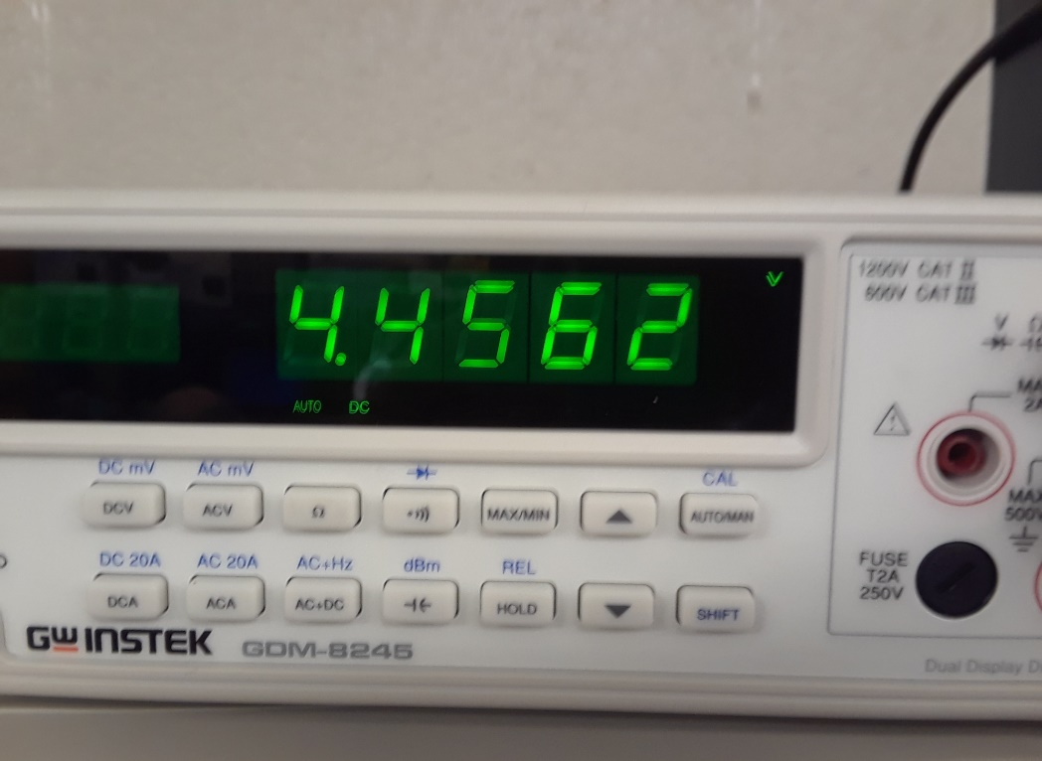
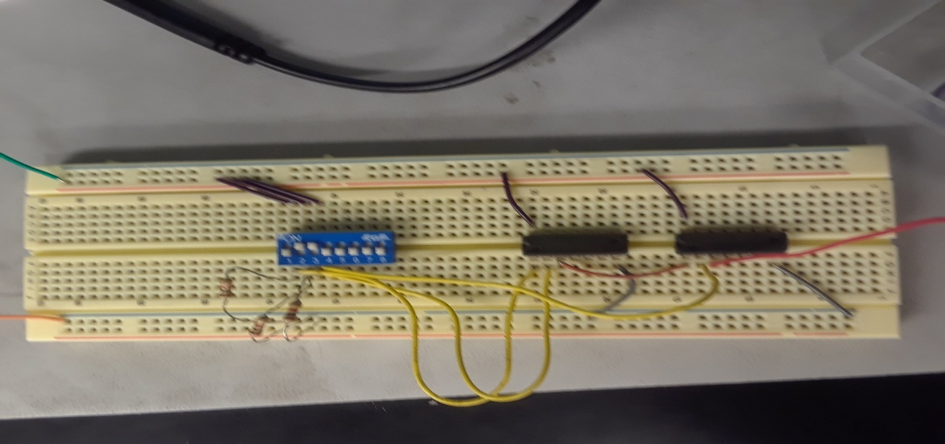
Lab 4: Pics
This is the read when switch 2 and 3 are on in the multisim where the output of the OR gates goes into the input of the AND gate . We read a voltage of 4.4562 (0,1,1)

Slide 32
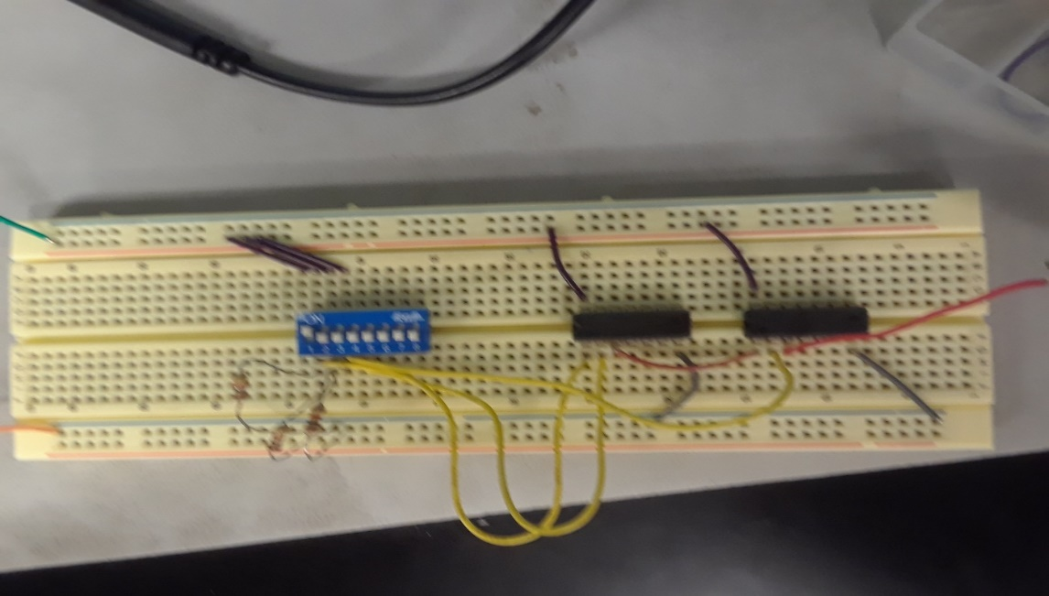
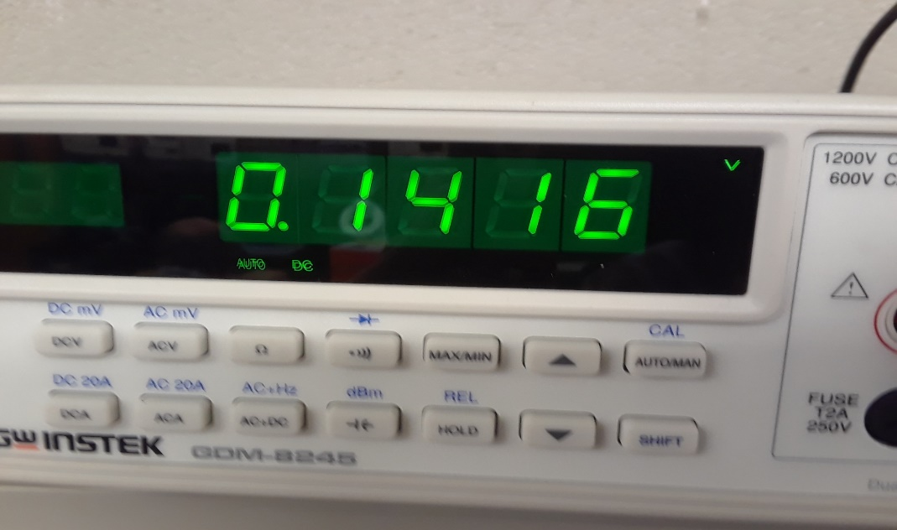
Lab 4: Pics
This is the read when switch one is on in the multisim where the output of the OR gates goes into the input of the AND gate . We read a voltage of .1416. (1,0,0)

Slide 33
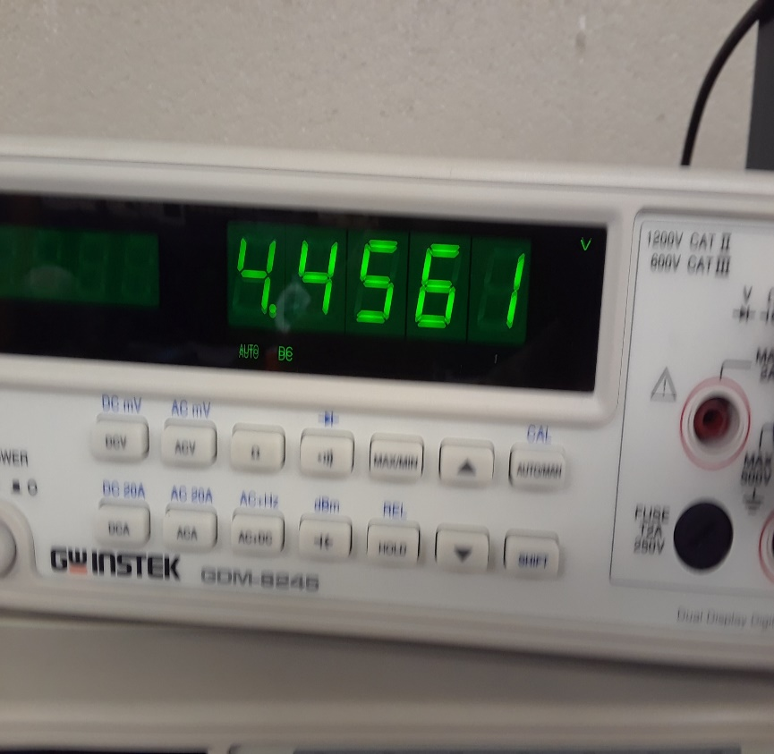
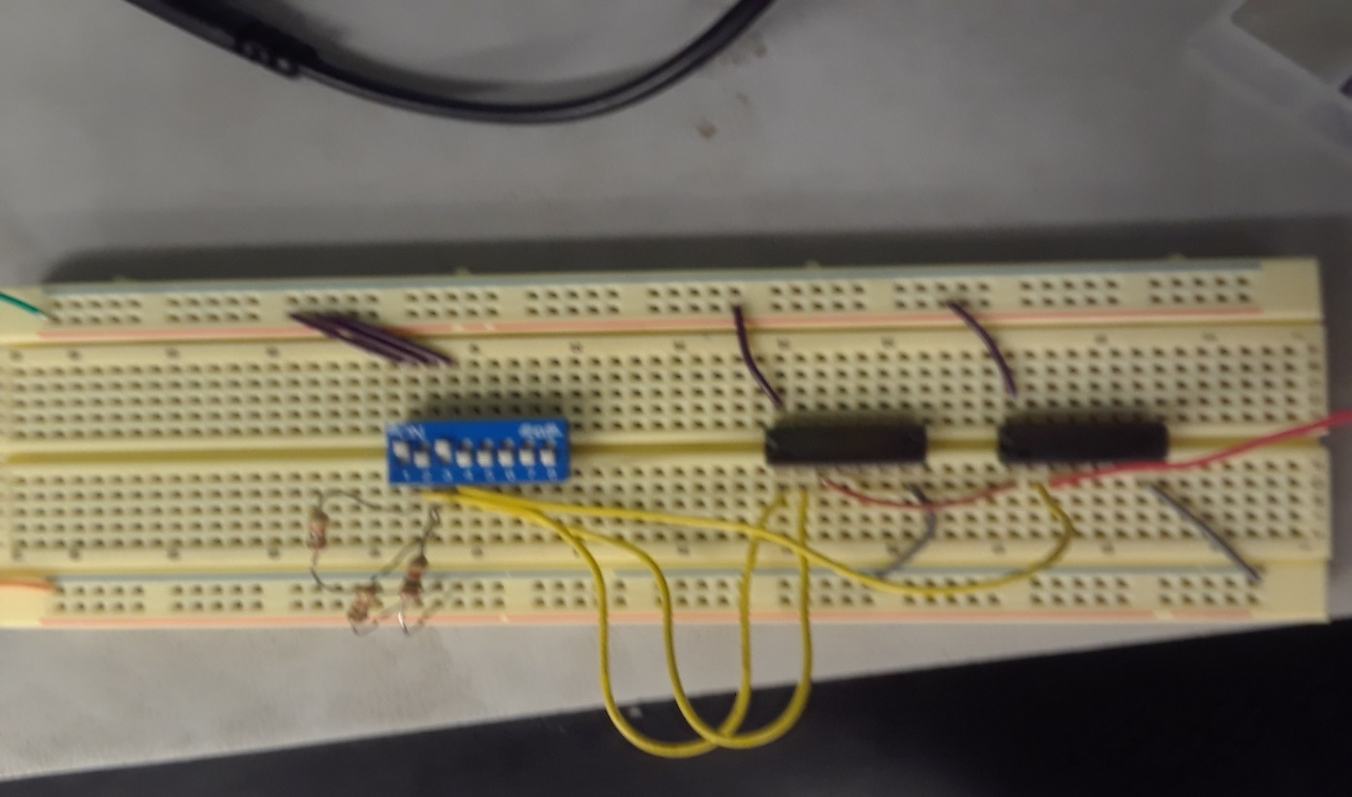
Lab 4: Pics
This is the read when switches 1 and 3 are on in the multisim where the output of the OR gates goes into the input of the AND gate . We read a voltage of 4.4561.(1,1,1)

Slide 34
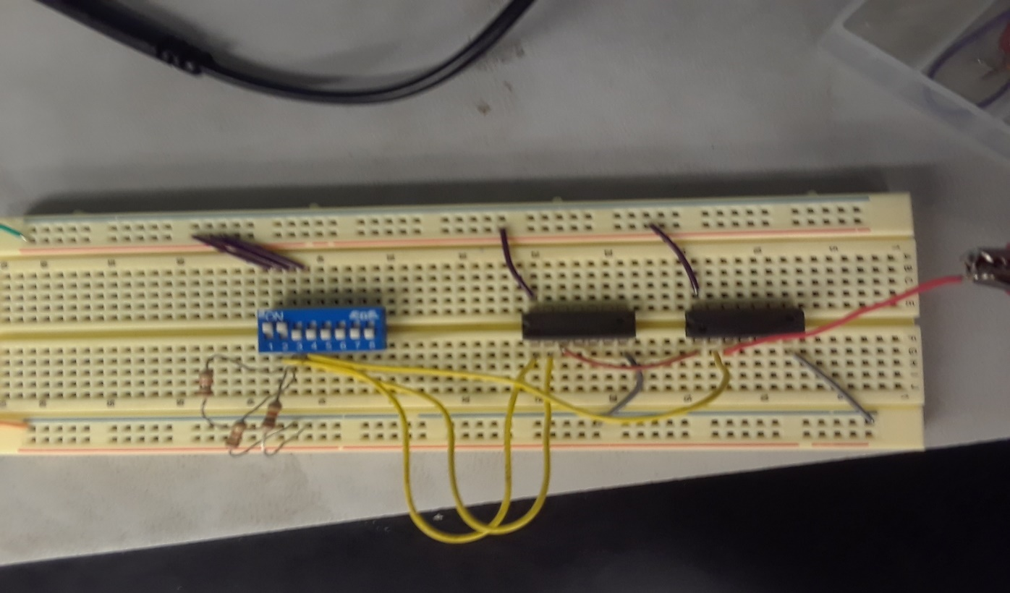
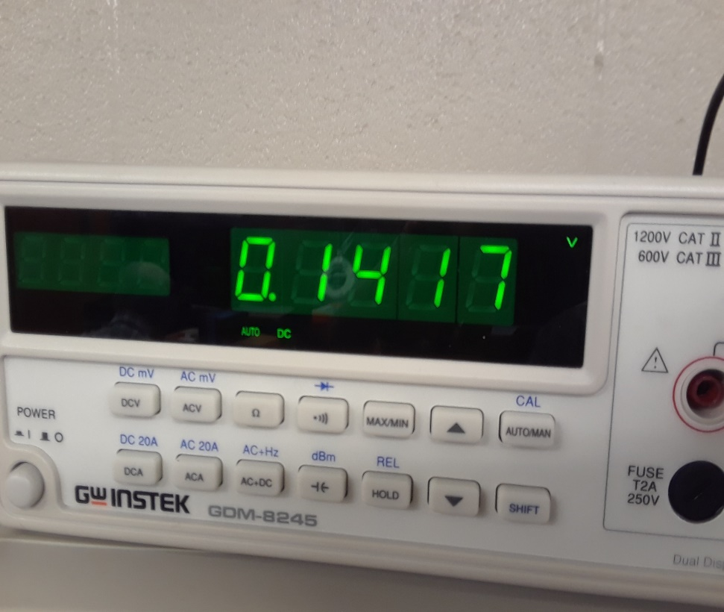
Lab 4: Pics
This is the read when switch one and two are on in the multisim where the output of the OR gates goes into the input of the AND gate . We read a voltage of .1417. (1,1,0)

Slide 35
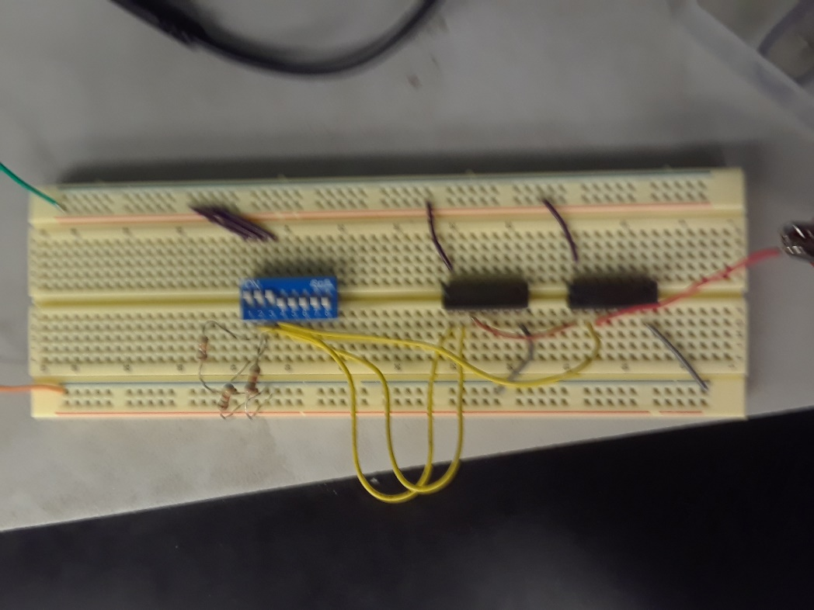
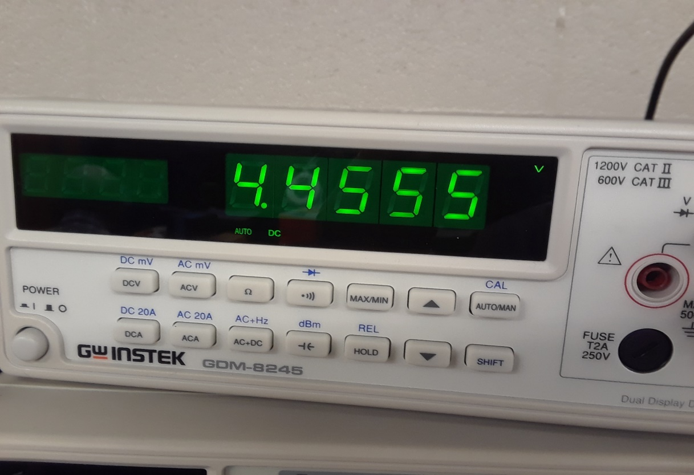
Lab4: Pic
This is the read when all the switches are on in the multisim where the output of the OR gates goes into the input of the AND gate . We read a voltage of 4.4555. (1,1,1)

Slide 36
Lab 4: Results For Output of AND Gate going Into Input of OR Gate

Slide 37
Lab 4: Results For Output of OR Gate going Into Input of AND Gate
Excel Sheet for slide 20 and 21

Slide 38
Observations
For lab 4 the voltage was to low to use a 10k resistors so we had to switch over to a 1k resistor. The real world voltage was more like 4 volts compared to 5 volts in the simulation.

Slide 39
Lab 5: Two Input Gates Date:12-11-17
The purpose of this lab is to:
Test how two input logic gates work using digital ICs, switches and resistors.
Equipment needed:
1 – Digital Multimeter
2 – 10Kohm
1 – 4 position dip switch
1 – 74LS04 Hex Inverter
1 – 74LS08 Quad AND
1 – 74LS32 Quad OR
1 – 74LS86 Quad XOR

Slide 40
Lab 5 Multisim
This multisim includes all the different types of gates

Slide 41
Lab 5: Simulated
A = | 0 | 0 | 1 | 1
B = | 0 | 1 | 0 | 1
OR | 1 | 1 | 1 | 0
AND | 1 | 0 | 0 | 0
XOR | 0 | 1 | 1 | 0
NOR | 0 | 0 | 0 | 1
NAND | 0 | 1 | 1 | 1
XNOR | 1 | 0 | 0 | 1
Lab 5 Word Doc

Slide 42
Lab 5: Observation
The XNOR,NAND, NOR and XOR gate are a few logic states off from the original AND and OR gates

Slide 43
Lab 6 Date:10-13-17
Partners: Jarred Clark, Seth Wills, Emmanuel Ayiku-Teye
The purpose of this lab is to:
Verify as many of the 17 Theorems with Multisim
Using Multisim simulate the Theorems and record in tables below. Then compare simulation results to the 17 Theorems.

Slide 44
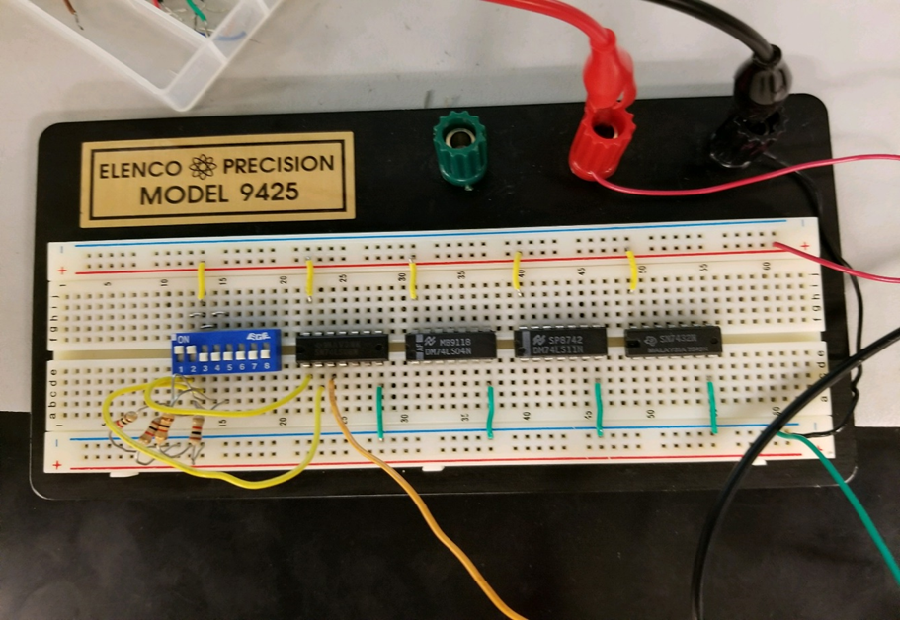

Lab 6-Page 2
Theorem 1 of Demorgans Theorems
This is the completed circuit for Theorems 1-3

Slide 45
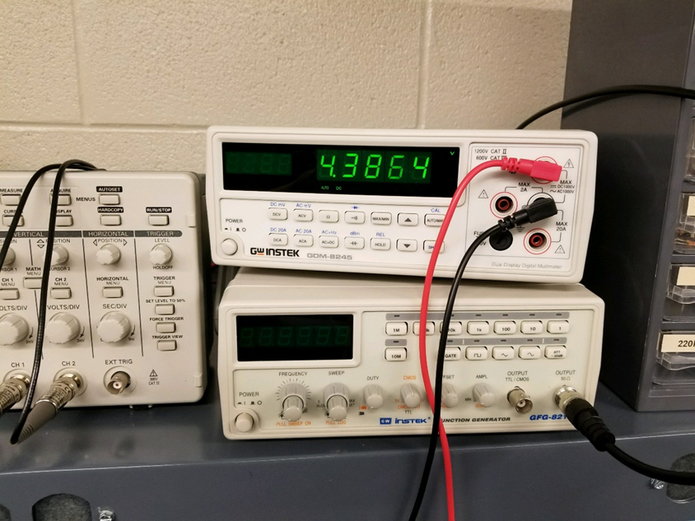

Lab 6- Page 3
Theorem 2 of Demorgans Theorem

Slide 46

Lab 6- Page 4
Theorem 3 of Demorgans Theorems

Slide 47
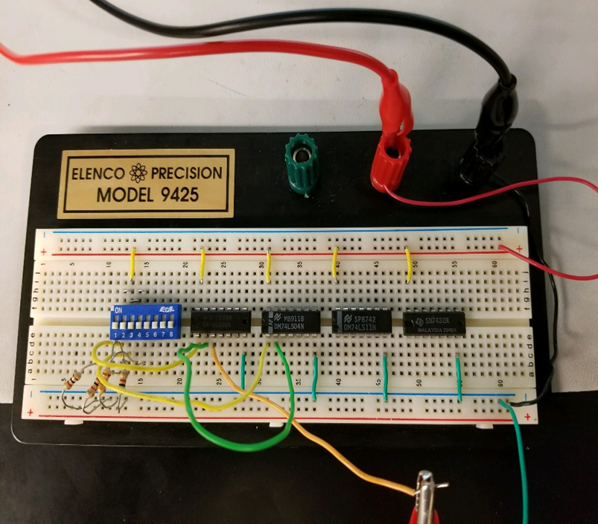
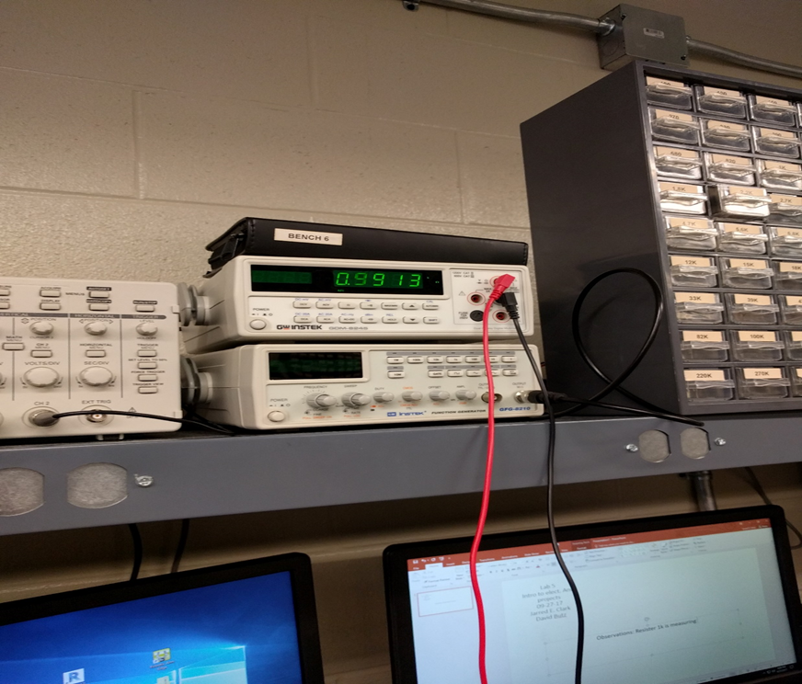

Lab 6- Page 5
Theorem 4 of Demorgans Theorems
This is the finished circuit of theorem 4

Slide 48
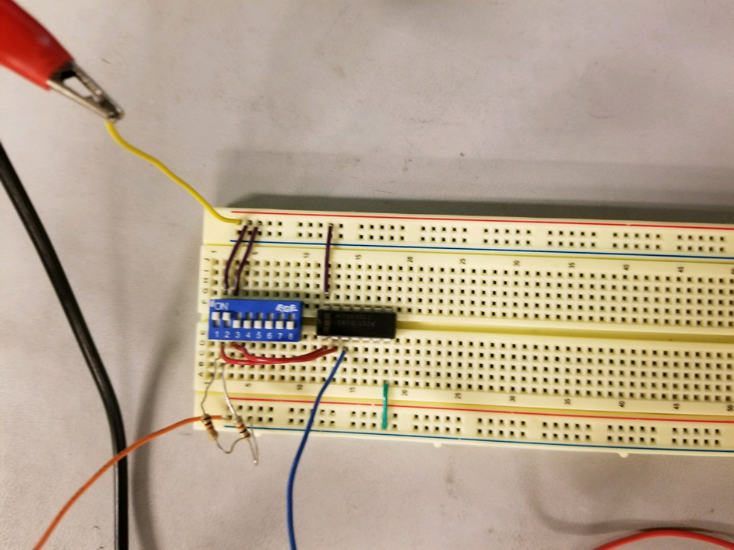
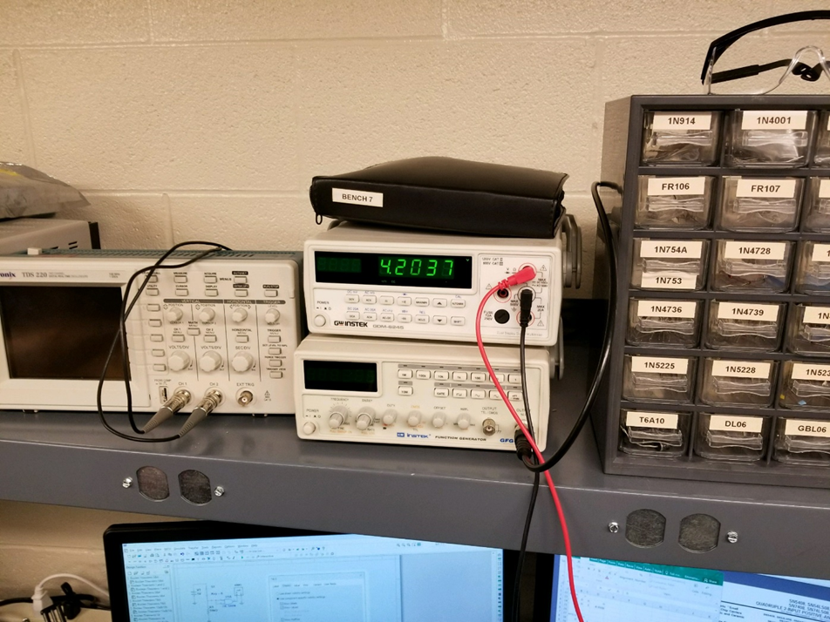

Lab 6- Page 6
Theorem 5 of Demorgans Theorems
This is the completed circuit for Theorems 5-7

Slide 49

Lab 6- Page 7
Theorem 6 of DeMorgan theorem

Slide 50
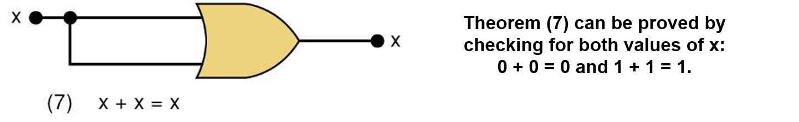
Lab 6 Page 8
Theorem 7 of DeMorgan

Slide 51
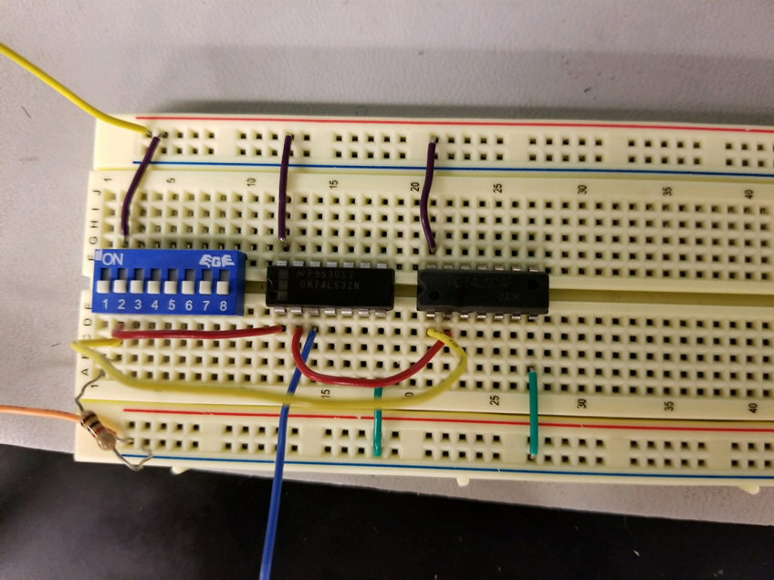


Lab 6 Page 9
Theorem 8 of DeMorgan Theorem
This is the completed circuit of Theorem 8

Slide 52
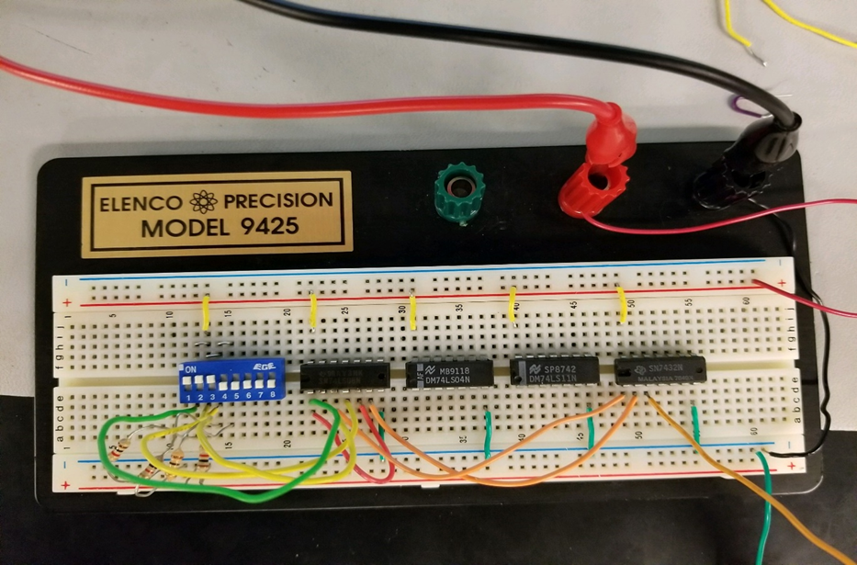
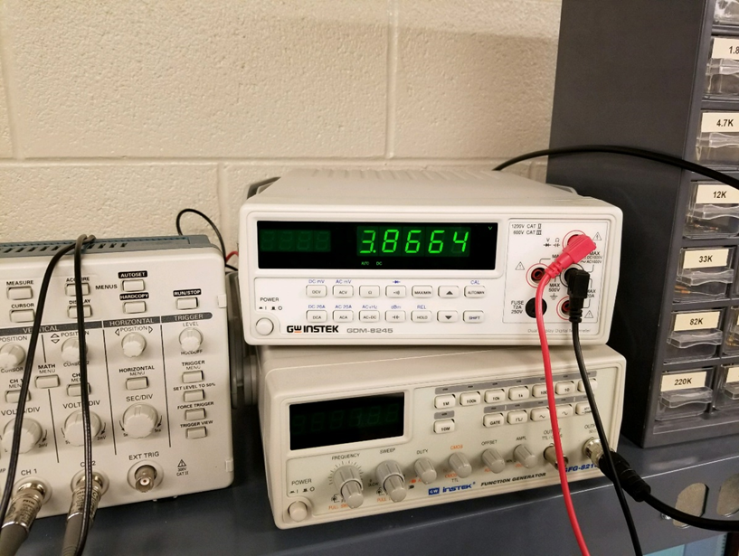

Lab 6- Page 10
Theorem 13a Part 1 of Demorgans
Theorem
This is the completed circuit for Theorem 13 a Part 1

Slide 53
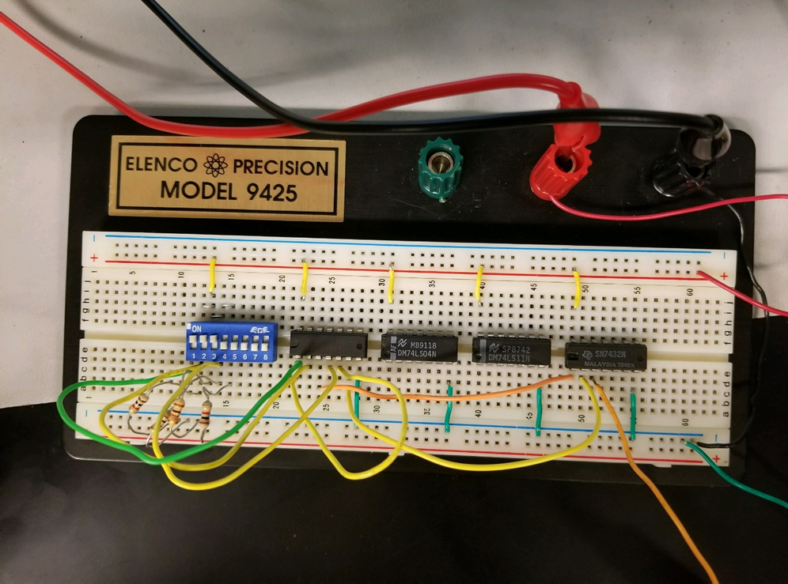
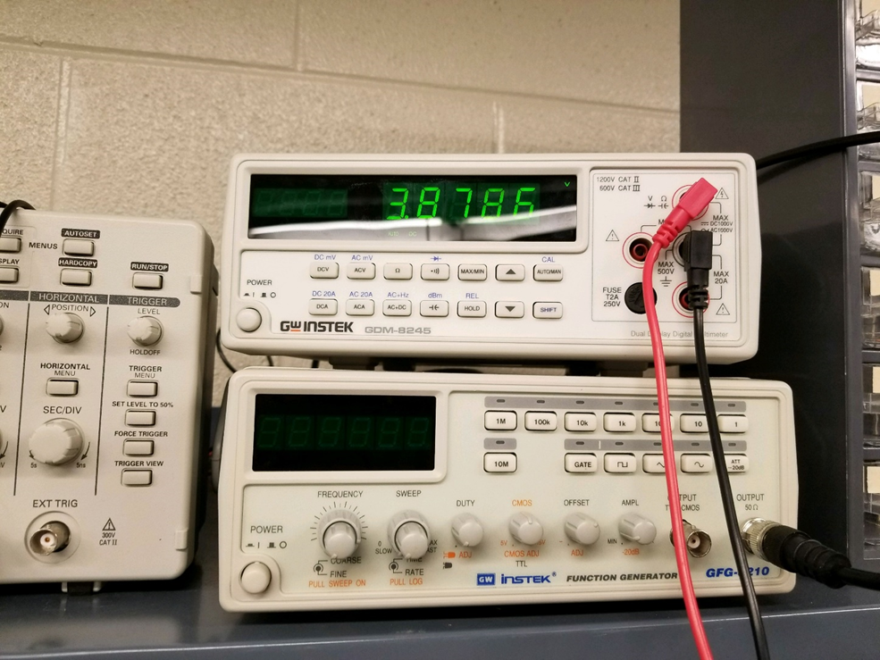
Lab 6- Page 11
Theorem 13a Part 2 of Demorgans Theorem
This is the complete circuit of Theorem 13 a Part 2

Slide 54
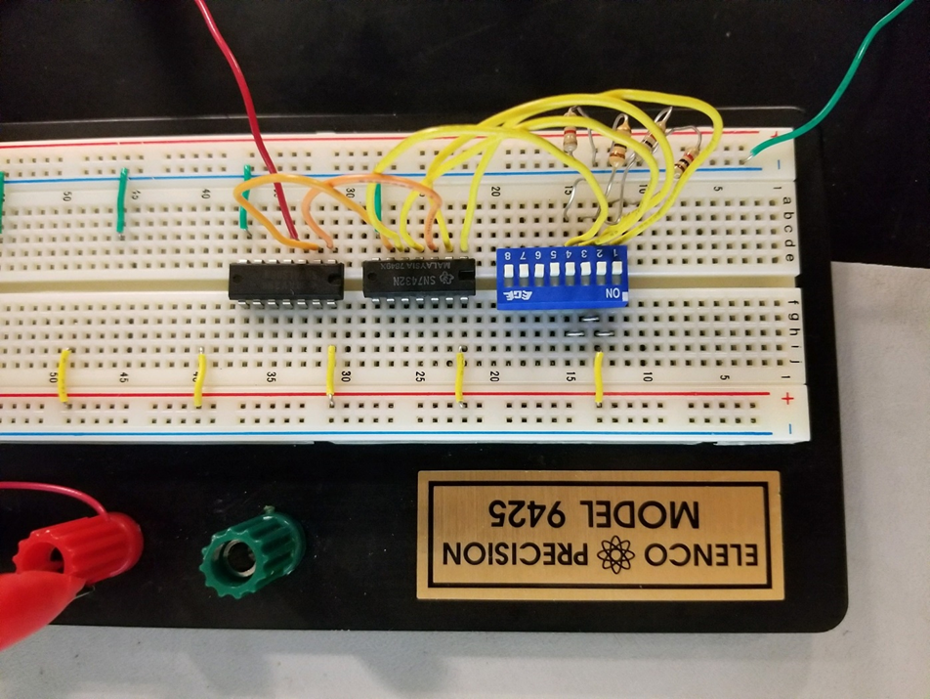
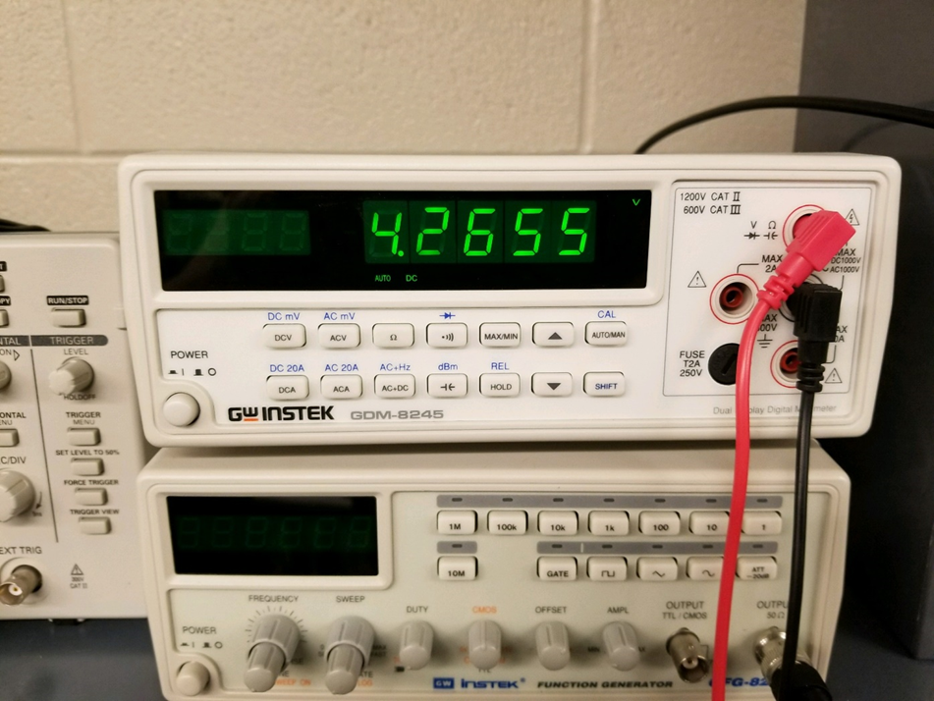
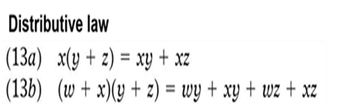
Lab 6- Page 12
Theorem 13b Part 1 of Demorgans Theorems
This is the completed circuit for Theorem 13b Part 1 and Part 2

Slide 55
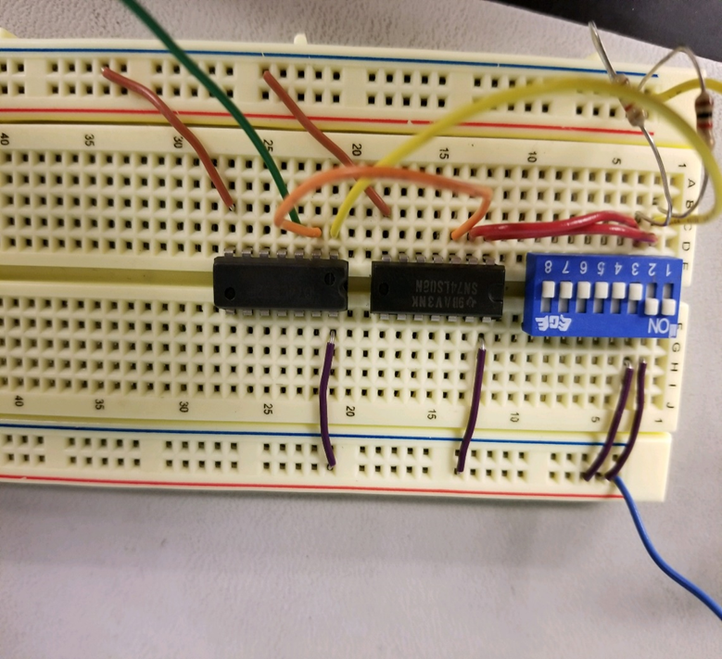

Lab 6- Page 14
Theorem 14 of Demorgans Theorems
Theorem 14 is x+xy=x
This is the completed circuit for Theorem 14

Slide 56
Lab 6- Page 13
Theorem 13b Part 2 of Demorgans Theorem

Slide 57
Lab 7:Circuit Reduction (Part 1) Date:10-27-2017
Partner: Jose Tapia
The purpose of this lab is to:
Test how to reduce a circuit design down to the smallest size using the 17 Theorems and Karnaugh maps. Part 2 will explore how to reduce the circuit.
Equipment needed:
1 – Digital Multimeter
3 – 10Kohm
1 – 4 position dip switch
1 – 74LS04 Hex Inverter
1 – 74LS00 Quad NAND
1 – 74LS11 Triple 3 input AND
1 – 74LS32 Quad OR

Slide 58
Lab 7: Multisim

Slide 59
Lab7: Multisim results
A | B | C | Output
0 | 0 | 0 | 0
0 | 0 | 1 | 0
0 | 1 | 0 | 0
0 | 1 | 1 | 0
1 | 0 | 0 | 1
1 | 0 | 1 | 1
1 | 1 | 0 | 0
1 | 1 | 1 | 1

Slide 60

Lab 7: Tested Picture
This is the circuit before we had to figure out how to reduce it. We use 3 input AND gate. The final test result came out of an OR gate.

Slide 61
Lab7: Tested Results
A | B | C | Output
0 | 0 | 0 | 0
0 | 0 | 1 | 0
0 | 1 | 0 | 0
0 | 1 | 1 | 0
1 | 0 | 0 | 1
1 | 0 | 1 | 1
1 | 1 | 0 | 0
1 | 1 | 1 | 1

Slide 62

Lab7: SOP and POS
Lab 7 word document

Slide 63
Lab 7: Observations
This is the circuit where we were able to reduce it later in lab 8. Also where we were able to find out the SOP and POS. Which will help us later down the in lab 8

Slide 64
Lab8:Circuit Reduction (Part 2) Date:11-10-17
Partners: Emmanuel Ayiku-Teye, Jose Tapia
The purpose of this lab is to:
Test how to reduce a circuit design down to the smallest size using the 17 Theorems and Karnaugh maps. Part 2 will explore how to reduce the circuit. You will also need the results of Lab 7.
Equipment needed:
1 – Digital Multimeter
3 – 10Kohm
1 – 4 position dip switch
1 – 74LS04 Hex Inverter
1 – 74LS08 Quad AND
1 – 74LS32 Quad OR

Slide 65
Lab 8: Multisim
This multisim is the sum of products reduction from lab 7
This multisim is the product of sum reduction from lab 7

Slide 66
Lab 7: Simulated Results
A | B | C | Lab 7 | SOP | POS
0 | 0 | 0 | 0 | 0 | 0
0 | 0 | 1 | 0 | 0 | 0
0 | 1 | 0 | 0 | 0 | 0
0 | 1 | 1 | 0 | 0 | 0
1 | 0 | 0 | 1 | 1 | 1
1 | 0 | 1 | 1 | 1 | 1
1 | 1 | 0 | 0 | 0 | 0
1 | 1 | 1 | 1 | 1 | 1

Slide 67


Lab8: Bread Board
This is the build for SOP reduction
This is the POS reduction

Slide 68
Lab8:Tested results
A | B | C | Lab 7 | SOP | POS
0 | 0 | 0 | 0 | 0 | 0
0 | 0 | 1 | 0 | 0 | 0
0 | 1 | 0 | 0 | 0 | 0
0 | 1 | 1 | 0 | 0 | 0
1 | 0 | 0 | 1 | 1 | 1
1 | 0 | 1 | 1 | 1 | 1
1 | 1 | 0 | 0 | 0 | 0
1 | 1 | 1 | 1 | 1 | 1
Lab 8 Word Document

Slide 69
Lab 8: Observations
You can perform better logic using less components which less components equals less power

Slide 70
Lab 9- 1 to 3 clock using JK Flip Flops and 555 Timer 11-17-17
My Lab Partner was Seth Wills and Jarred Clark
The Purpose is to do as many times you can use multiple harmonically related clocks to test a combinational circuits. The Purpose of this lab is to show students how to create a small multiple clock counter circuit that uses JK Flip Flops and a 555 Timer.
Equipment needed:
1 – 555 Timer
1 – 1Kohm
1 – 4 position dip switch
2 – 74LS73 Dual JK flip flop with clear
2 – Resistors (To Be Designed)
2 – Capacitors (To Be Designed)

Slide 71
Lab 9- Page 2
This is the multisim schematic of just a single clock with two compacitors, 4.7k resistor, 100k resistor, and 555 Timer

Slide 72


Lab 9- Page 3
This is the completed circuit for the first schematic from Lab 9- Page 2
This is the correct oscilloscope reading for the circuit and it is reading at a frequency of 7hz.

Slide 73
Lab 9- Page 4
This is the multisim schematic for using a 1k resistor, 1 switch and 3 555 Timers.

Slide 74

Lab 9- Page 5
This is the complete circuit build for the schematic on Lab 9 – Page 4

Slide 75
Lab 9- Page 7
Observation: The 74LS73 flip flop followed the clock being generated by the 555 Timer Out put
The Original document Lab 9

Slide 76
Data Sheets for IC’s
74ls04
74ls08
74ls32

